Slide 1
Centre for Spatial Analysis
School of Geography and Geology
McMaster University
WELCOME TO
Advanced Topics
in Spatial Statistics
(510-654)

Slide 2
Instructor
Antonio Páez
Contact information:
  Burke Science Building 337/A
  E-mail: paezha@mcmaster.ca
  Telephone: 905-525-9140 ext. 26099
  Office hours: M, F 8:30 – 10:00 A.M.
Patrick DeLuca

Slide 3
Types of Spatial Data
Point patterns
Spatially continuous data
Area data

Slide 4
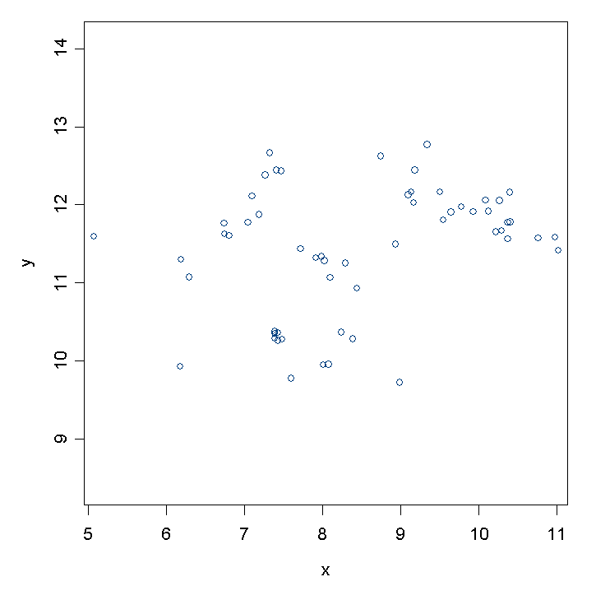
Point Pattern Data

Slide 5
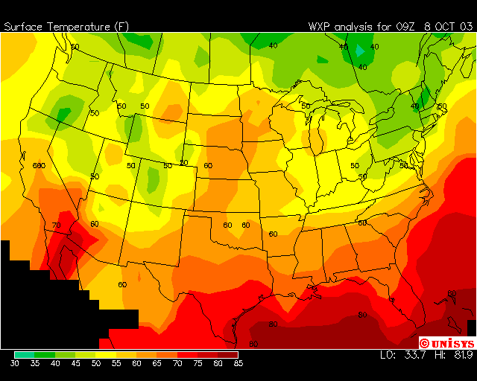
Spatially Continuous Data

Slide 6
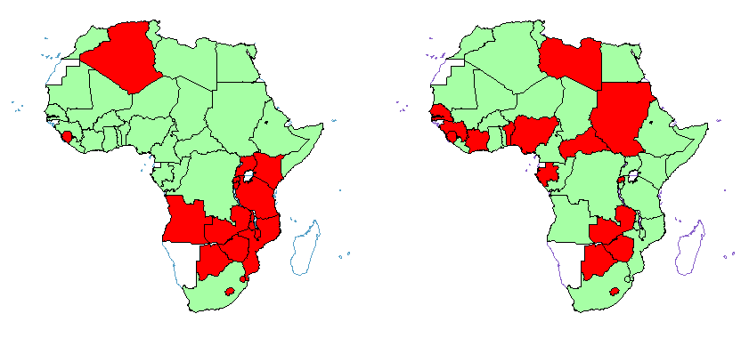

Area Data
BB = 18
BB = 9
Notes:
African independence (obs = left, random = right)

Slide 7
Analysis of Spatial Data
Visualization
  Mapping
Exploration
  First order/second order effects?
Modeling
  Statistically significant?
  Explanation?
Notes:
Exploration:
Highlighting and detecting patterns
Identify atypical observations (spatial outliers)
Discover patterns of spatial association (clustering)
Search for description of patterns, develop hypotheses
Visualization
mapping spatial distributions
outlier detection
smoothing rates

Slide 8
Course Description
Intermediate methods of spatial analysis
  Modeling
  Hypothesis testing
Course contents:
  Point Patterns
  Inference
  Correlation
  Regression Analysis
  Spatially Continuous Data
  Area Data

Slide 9
Modeling of Spatial Data
Formally test hypotheses through statistical methods (inference)
Estimate strength and direction of relationships (regression analysis)
Usually proceeds by identifying any heterogeneities in mean value and then modeling residuals or deviations from this trend

Slide 10
Spatial Data and Spatial Correlation
Spatial structure often exhibit degree of spatial correlation – need to incorporate this spatial dependence in model
Behavior of spatial phenomena is usually result of mix of 1st and 2nd order effects
Notes:
Book uses example of ozone level. While ozone concentration will differ from location to location, ozone levels at neighboring locations are likely to be related somehow. Similarly, house prices will vary over space, but neighboring ones are related.

Slide 11
Spatial Data and Order Effects
1st order effects relate to variation in the mean value of the processes in space – large scale, overall effects.
2nd order effects result from the spatial correlation structure, or spatial dependencies in the process
Notes:
2nd order effects look at small or local scale effects. In other words, the tendency for deviations in values of the process from its mean to ‘follow’ each other in neighboring sites.
Real-life spatial patterns frequently arise from mixture of 1st and 2nd order effects, so that independence in the random variables representing a spatial stochastic process if usually too strong an assumption for spatial modeling. (we assume independence in non-spatial regression analysis). By definition, the assumption of independence rules out second order effects. Therefore, the assumption is replaced with a weaker one that allows for the possibility of covariance. A common approach is to think of the variable of interest (ozone, house prices) to have two components. The first order component represents a large scale spatial variation in the mean – this does not need to be linear. The second order component deals with behavior of the stochastic deviations from this mean. Instead of assuming these to be spatially independent, they are allowed to have a covariance structure which gives rise to local effects.

Slide 12
Spatial Data and Order Effects
2nd order component often modeled as a stationary spatial process.
A process {Y(s), s∈R} is stationary (homogenous) if its statistical properties are independent of location in R.
This implies that mean E(Y(s)) and variance VAR(Y(s)) are constant in R (i.e., do not depend on location)

Slide 13
This session:
Course Outline
  Course objectives
  Evaluation
  Guidelines and regulations
  Structure of weekly lectures and other activities

Slide 14
Course Outline
Course objectives:
  Demonstrate sound geographical problem-solving skills.
  Correctly identify different types of spatial data, and to select appropriate analytical methods and techniques.
  Describe and discuss the main elements of the above methods and techniques.

Slide 15
Course Outline
Course objectives:
  Proficiently use the S-PLUS computer package and its spatial statistics module to analyze spatial data.
  Interpret the result of your analysis, and to support your interpretation with articulate descriptions of a spatial process.

Slide 16
Course Evaluation
Evaluation scheme:
Group projects (3@20% each): | 60%
Exercise 1 (individual): | 10%
Final examination: | 30%
Dataset (Bonus): | 10%
Total: | 110 %

Slide 17
Course Guidelines and Regulations
Contacting the instructor:
  Office hours
  E-mail or phone to set an appointment
  Technical questions only by e-mail or in person

Slide 18
Course Guidelines and Regulations
Course preparation:
  3 hours of prep/study time for each hour of lecture
  More preparation = higher grades
  Problems with the course? See one of the instructors. Early identification of problems may help to solve them

Slide 19
Course Guidelines and Regulations
Handing in the projects:
  Directly to Pat DeLuca before or at the beginning of assigned lab session
  Late submissions: There are no late submissions

Slide 20
Course Guidelines and Regulations
Mark appeals:
  Appeals in writing: 24 hours rule (Within 15 days of receiving the work back)
  Re-marking may result in a higher or lower grade!

Slide 21
Course Guidelines and Regulations
Students with special needs:
  Contact the Centre for Student Development
    Student Centre UB107
    905-525-9140 ext. 24711
  Accommodations are arranged exclusively through the office of Services for Students with Disabilities (http:/csd.mcmaster.ca/css/disabilities.html)

Slide 22
Course Guidelines and Regulations
Missed work
  Valid reasons include, but are not limited to:
    Illness
    Death of a family member
    Religious holidays
  These situations are handled on a case-by-case basis

Slide 23
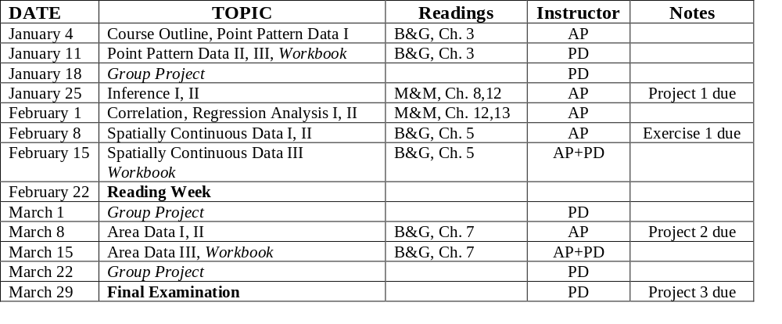
Lectures and other events
Tentative schedule: lectures and exams
Notes – AP: Antonio Páez; PD: Pat DeLuca
B&G: Bailey and Gatrell; M&M: McGrew and Monroe

Slide 24
Lectures
Lectures organized in Sessions
Structure of a lecture
6:30 – 7:45
In-class time
8:00 – 9:15
In-class time
Break

Slide 25
Labs
The labs are on a 1:1 relationship to the lectures in the case of:
  Point patterns
  Spatially continuous data
  Area data
Start working early on projects and exercises

Slide 26
Questions? Comments?

Slide 27
Next…
Point pattern analysis I

